Slide 1
Presentation Data 603
By: Hafsa Chaudhry

Slide 2
MY Problem Statement
Since the beginning of 2020 to present, there has been roughly 500,000 reported crime cases in Los Angeles alone. The majority of victims being the ages of 23-25, and female. How can we lower the likelihood of people in LA being victim of crime ?

Slide 3
My Source Data, Along with some initial data exploration
Kaggle. Kaggle has a good variety of data sets on machine learning. It requires registration but is worth it.
https://www.kaggle.com/datasets/hemil26/crime-in-los-angeles

Slide 4
Data Set Basic Info
• 99.16 MB of data
• 4 files (3 PDFs and 1 CVS)
•20 columns
• Data is categorized by codes (suspicious activity, traffic violation, etc) along with a tag number for each code describing which category the crime falls under (drunk, blind, mental illness, etc)
• Columns include information such as: date and time, age/sex/ethnicity, location, weapon, status of the case

Slide 5
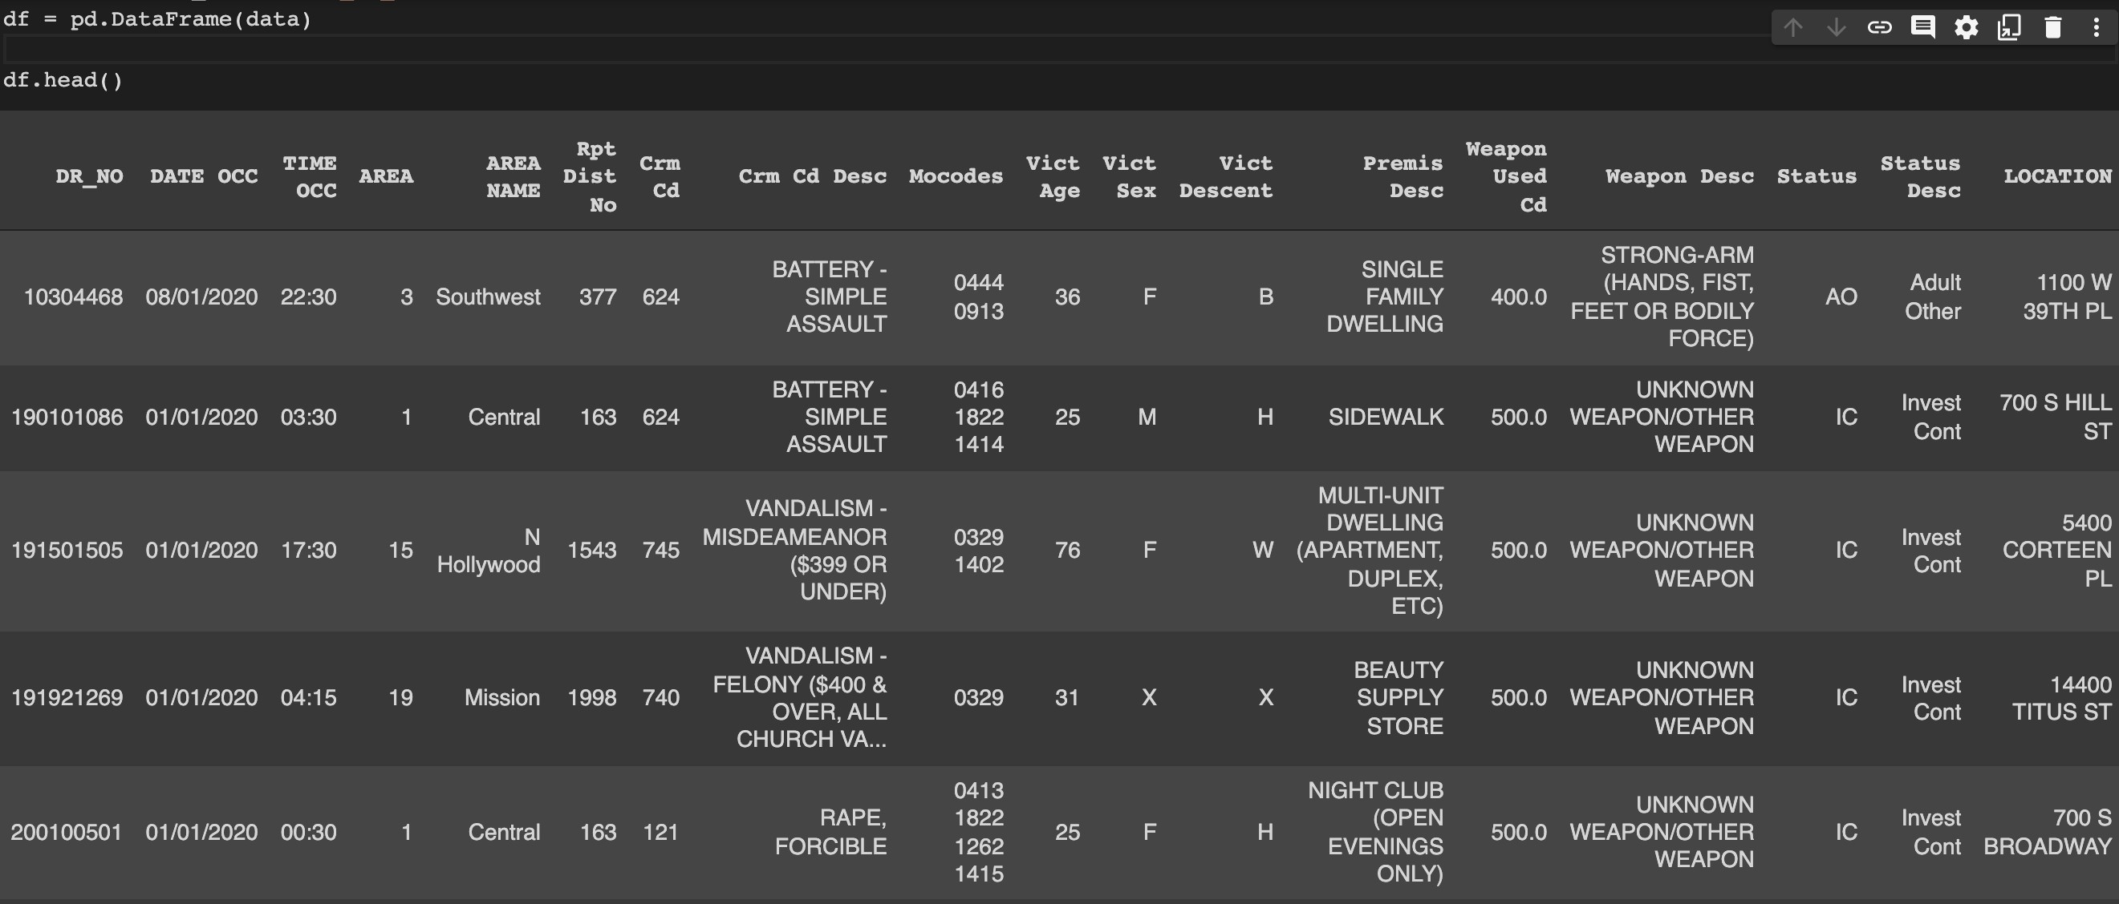
4

Slide 6
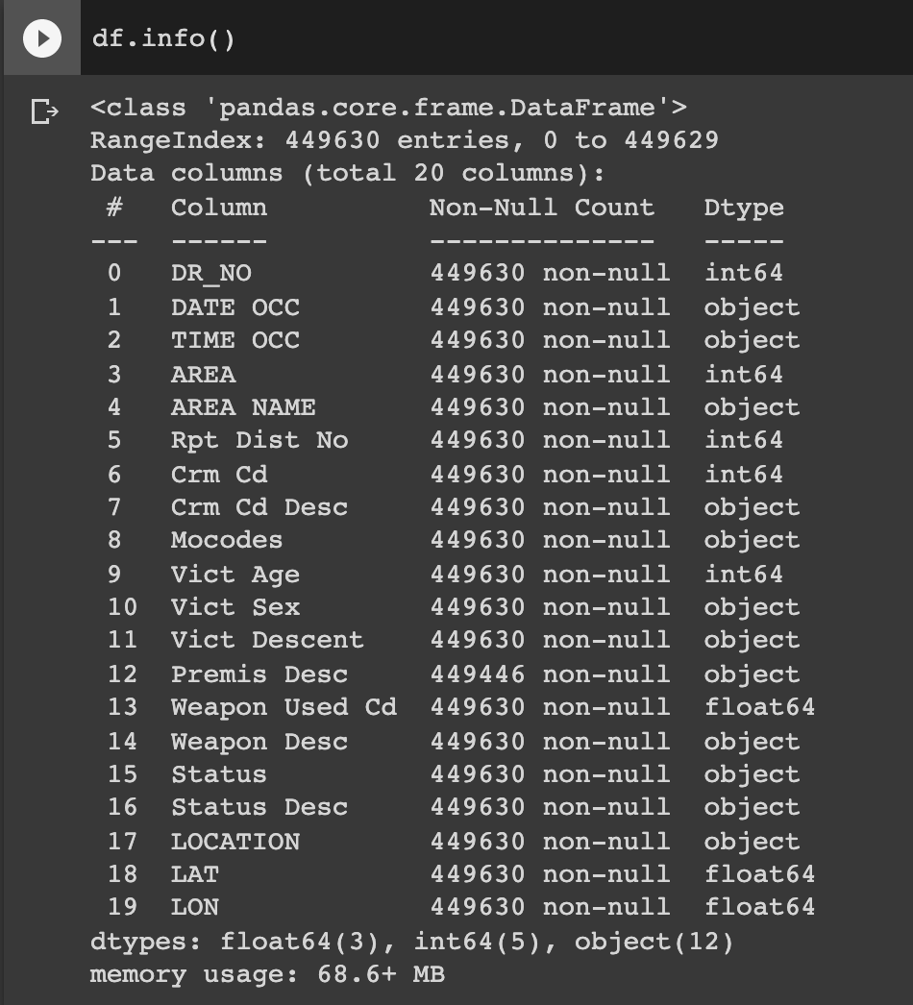
5

Slide 7
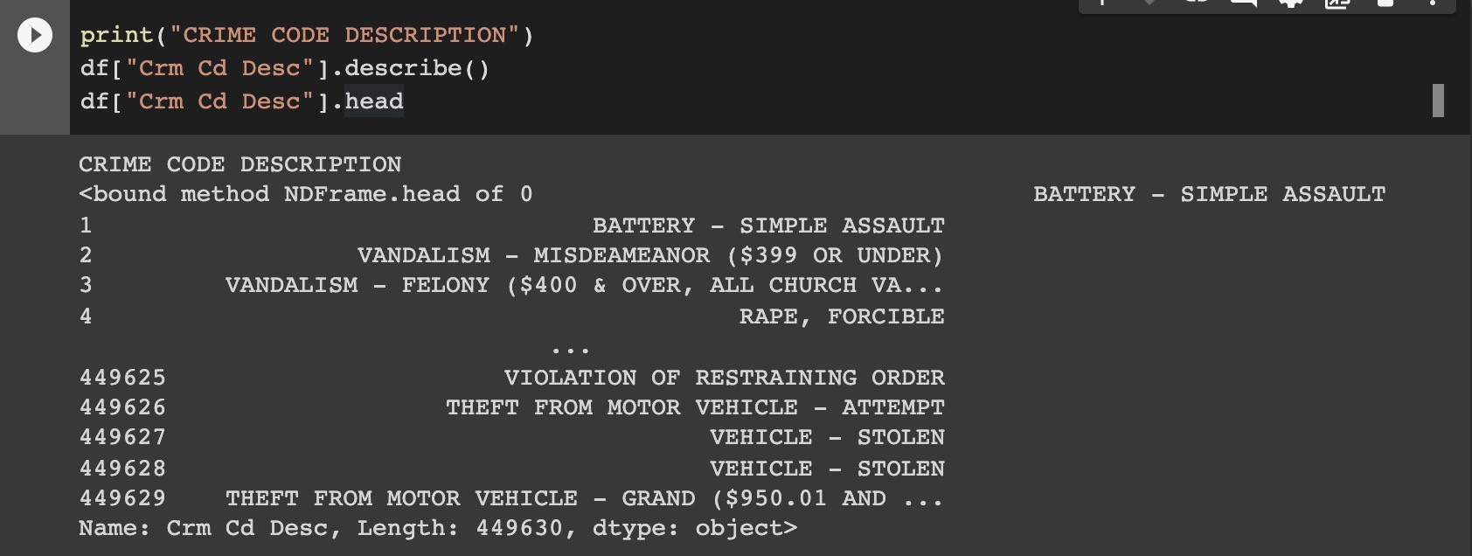
6

Slide 8
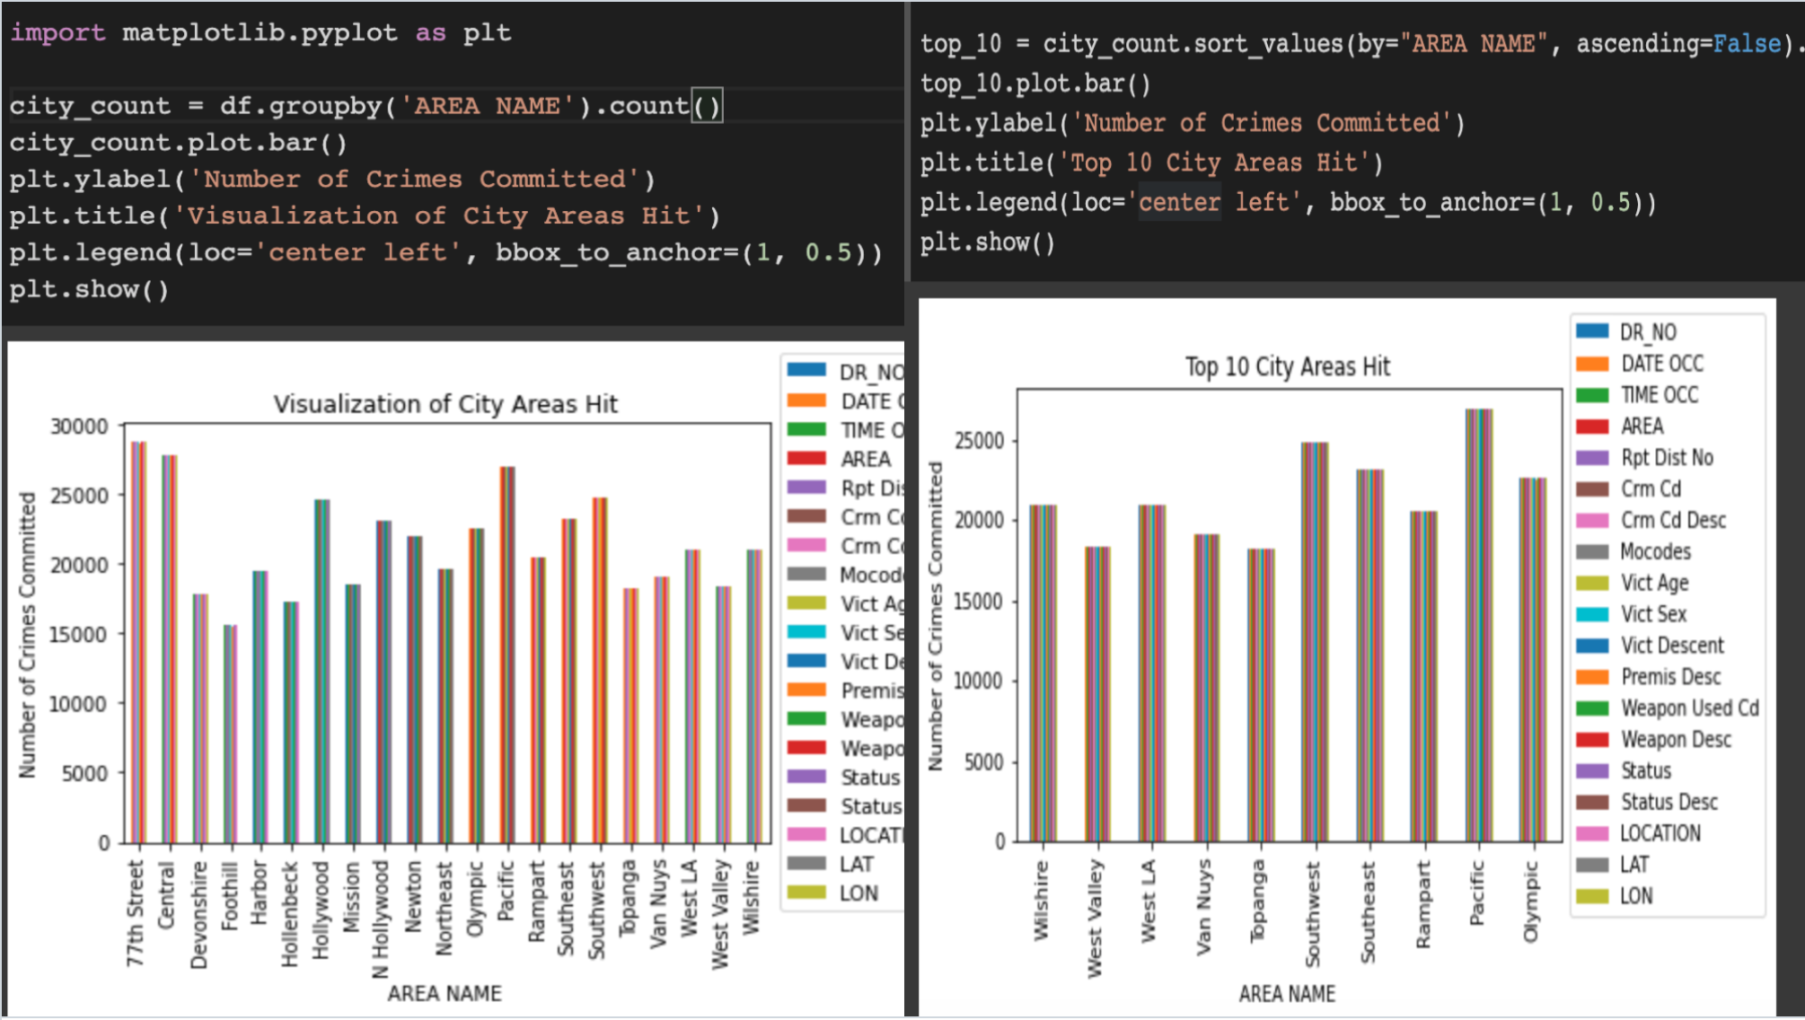

Slide 9
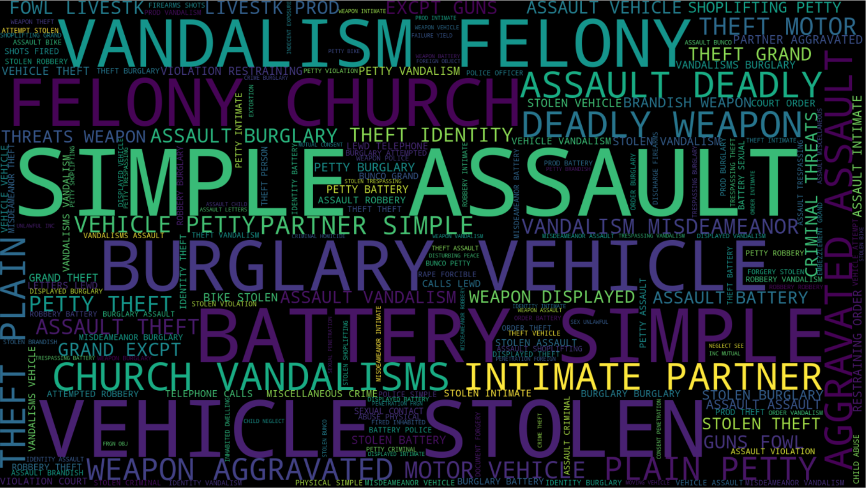

Slide 10
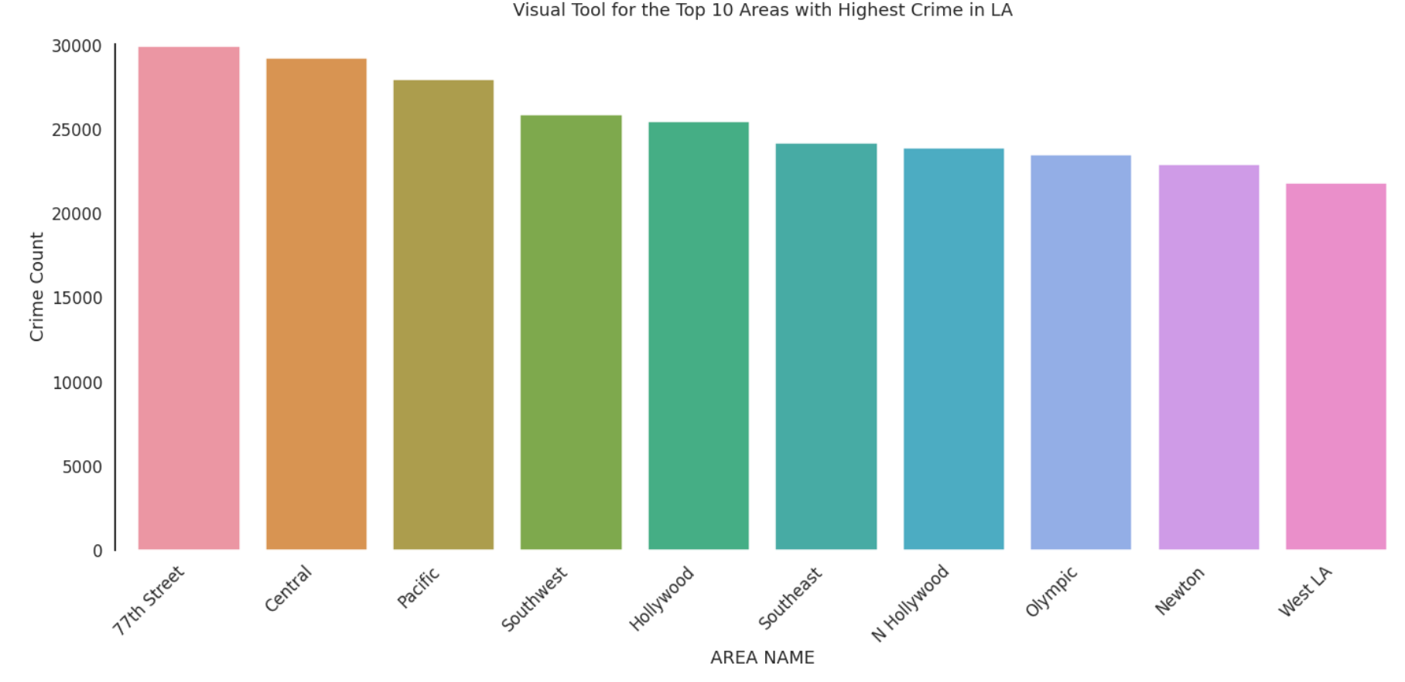

Slide 11
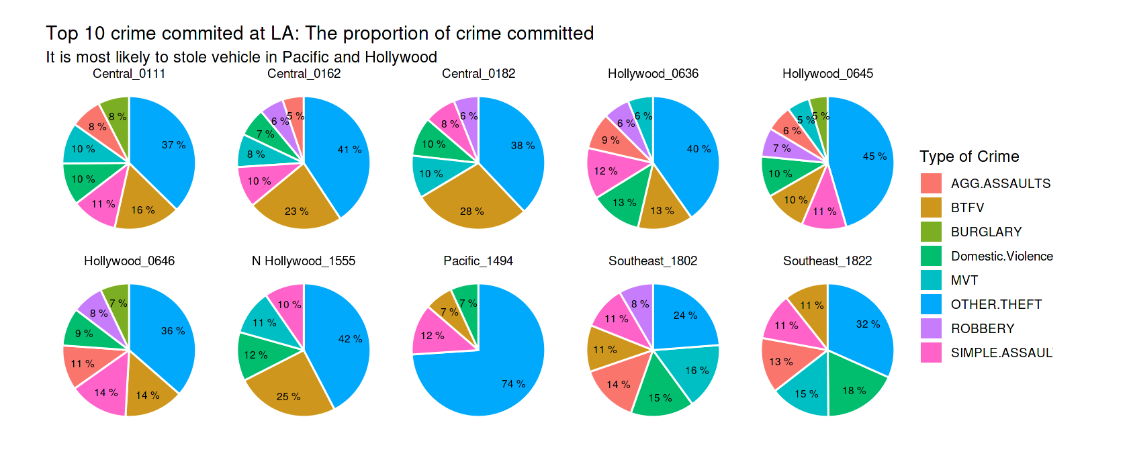
Notes:
From Kaggle…used for visual aid for class presentation

Slide 12
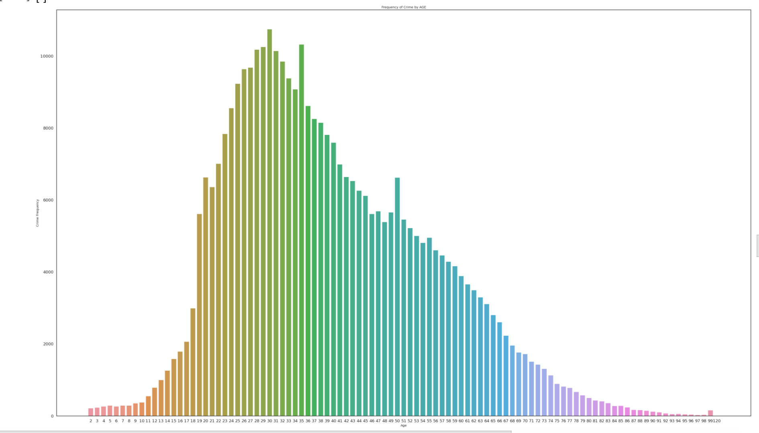
Notes:
KNOWN VICTIM AGE DISTRIBUTION WITHOUT OTHER

Slide 13
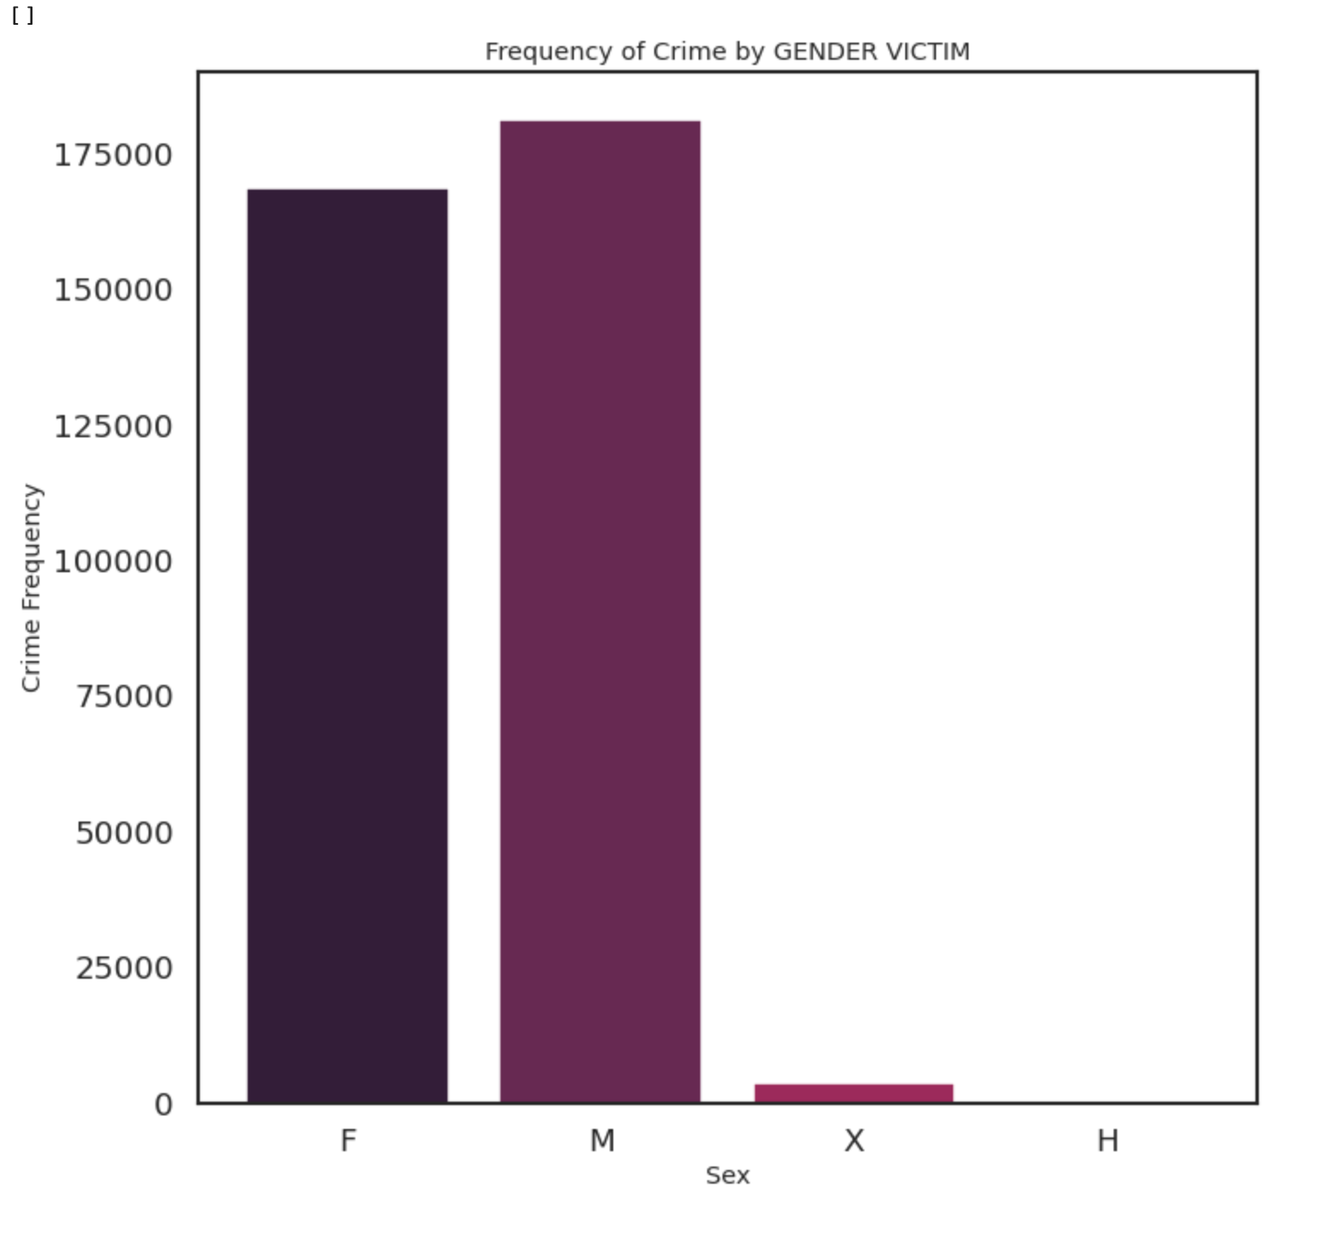
Notes:
VICTIM SEX DISTRIBUTION (There are unknown sex, Female, and Male) MORE MALE VICTIMS

Slide 14
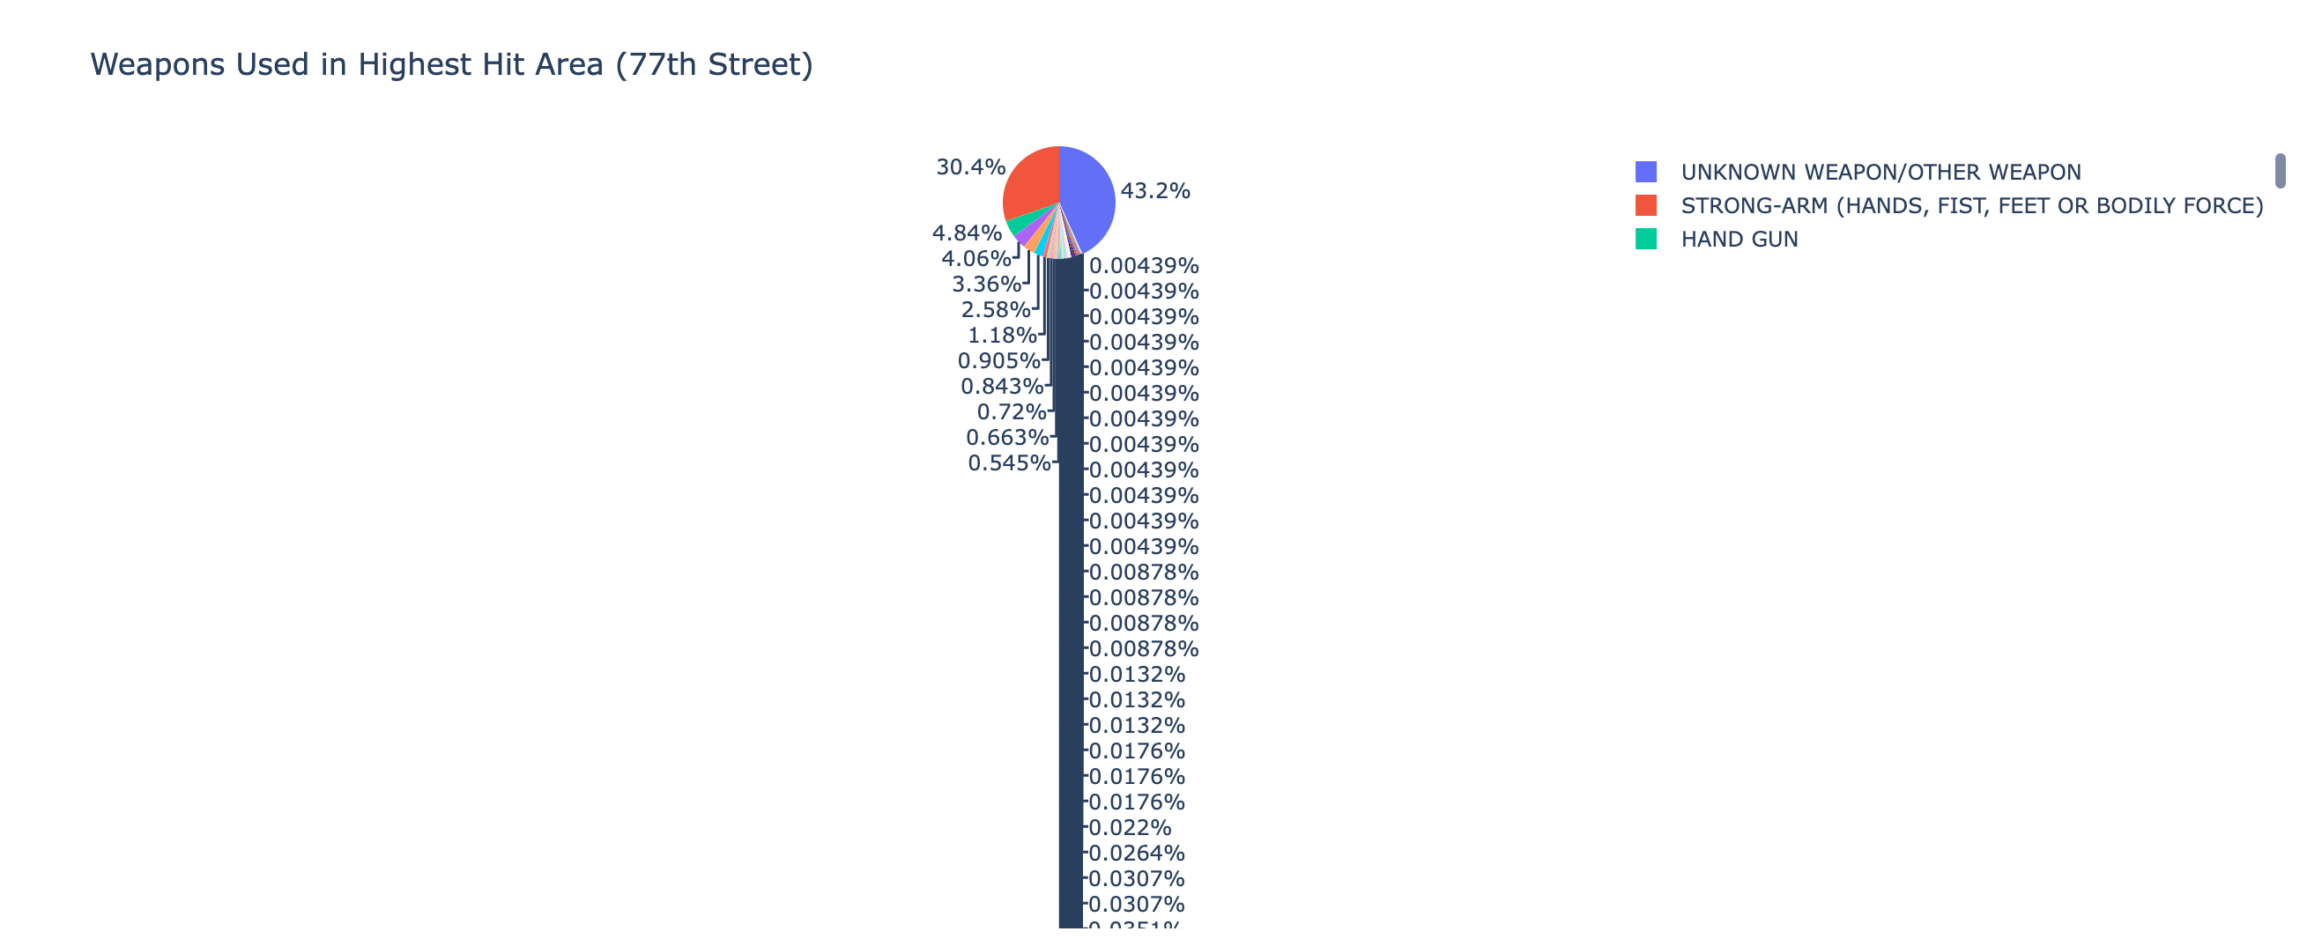
Notes:
LOTS OF UNKNOWN WEAPON, SECOND LARGEST IS STRONG ARM(hands, feet, body) AND HAND GUN

Slide 15
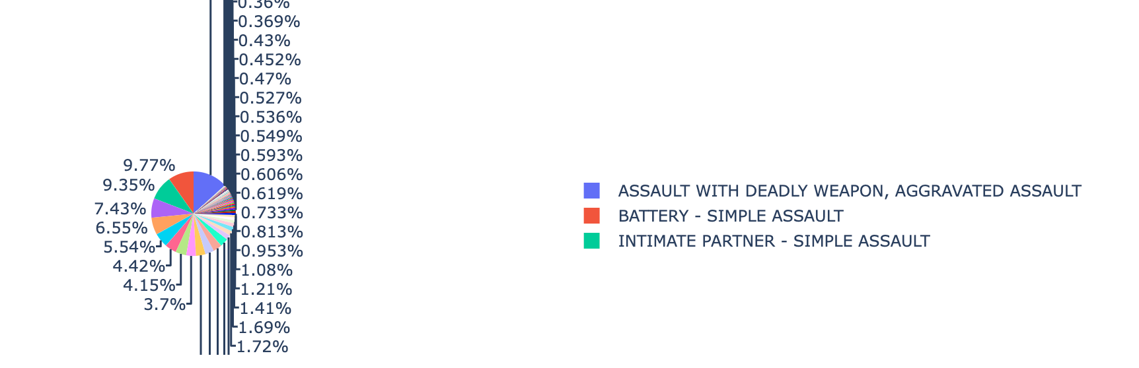
Notes:
TYPES OF CRIME MOST POPULAR in 77th street: ASSAULT WITH DEADLY WEAPON, BATTERY SIMPLE ASSAULT, AND SIMPLE ASSAULT BY INTIMATE PARTNER

Slide 16
My Proposed solution
My solution is purely data analysis:
By analyzing data for highest crime committed regions per timeframe, we can increase the presence of LAPD officers to monitor and prevent crime activity. (hope to prove that you can predict at certain times, crime is more likely in certain areas)
By creating visualization aid of types of crime and ages of victims correlating to area of crime, we can help create awareness to civilians in the area. (hope to prove that you can predict that type of crime and ages of victims are more correlated in certain areas)

Slide 17
CONCLUSION tbd
INTERACTION placer

Slide 18
Finished
Thank you!

